Slide 1


Bank Loan Of Customers Project

Slide 2
Index
Group Details
Project Details
KPI’s
Excel
My SQL
Tableau
Power BI

Slide 3
PROJECT DETAILS
Bank Loan of Customers.
Domain – Finance.
Datasets: Finance_1.xlsx & Finance_2.xlsx.
Project work done on Excel , My SQL , Power BI.
The project involved in analyzing loans provided by a financial institution to customers of diverse grades and sub-grade levels. The analysis encompassed factors such as loan disbursement reasons, funded amounts, revolving balance values, customer locations in various states and geographic locations, as well as customer payment modes, and the latest payment values.

Slide 4
Objectives
The main objective of Bank Loan Customers Project is to predict loan default likelihood, analyse key factors influencing loan repayment, and create informative visualizations to present findings effectively.
By utilizing Excel, Power BI, My SQL, and Tableau, we can streamline data processing, generate insights, and build interactive dashboards for a comprehensive analysis.
These objectives will guide us in leveraging the tools efficiently to achieve a thorough understanding of the loan data.

Slide 5

KPI’S
Year wise Loan Amount Status.
Grade & Sub Grade wise Revol_Bal.
Total Payment for Verified Status Vs Total Payment for Non Verified Status.
State wise and Month wise Loan Status.
Home Ownership Vs Last Payment Date Status.

Slide 6
Year wise loan amount StatUs
The trend in loan amounts over the years increases as from 2007 to 2011.
There is a huge loan amount for year 2011 as compared to 2007 year.
There is a consistent increase in loan amounts, it may indicate economic growth or inflation.
There's is need to monitor the trend regularly to adapt lending strategies accordingly.

Slide 7
Year wise loan amount Status

Slide 8
Grade & Sub Grade wise Revol_Bal.
The lowest orders with a review score of 2 using a credit card are 2,407.
Grade G having sub-grade G4 shows highest avg. revolving balance i.e. 24833 among all grade.
Grade A having sub-grade A2 shows lowest avg. revolving balance i.e. 9287 among all grade.
Higher revolving balances in specific grades/sub-grades might indicate a need for adjusted interest rates or credit limits.
We can observe that there is a huge difference between the review score 5 and review score 4 with is almost 33.37% of review score 5.
The reviews posted by the customer should be read carefully and a proper solution to the mention problem should be brought to increase the review score of orders that has a score of 1, 2 & 3.

Slide 9
Grade and sub grade wise revol_bal

Slide 10
Total Payment Vs Verification Status
The borrowers having verified status shows higher payment amount and having source-verified status shows lower payment amount.
It’s helps to identify significant differences in repayment behavior between these two groups.

Slide 11
State wise and Month wise Loan Statics
Analyze the distribution of loan statuses across different states and months.
Identify states or months with higher rates of loan defaults or late payments

Slide 12
Home ownership Vs last payment date statUs
By comparing the the last payment dates for borrowers with different home ownership statuses it Identify that 18846 people are interested in rent homeownership.
If homeowners consistently make more timely payments, it may indicate greater financial stability.

Slide 13
Excel
Data Cleaning
Import Data Into One Workbook.
Merged the data by using Power Query.
Created Pivot Table and Charts as Per KPIs
Created Dashboard

Slide 14
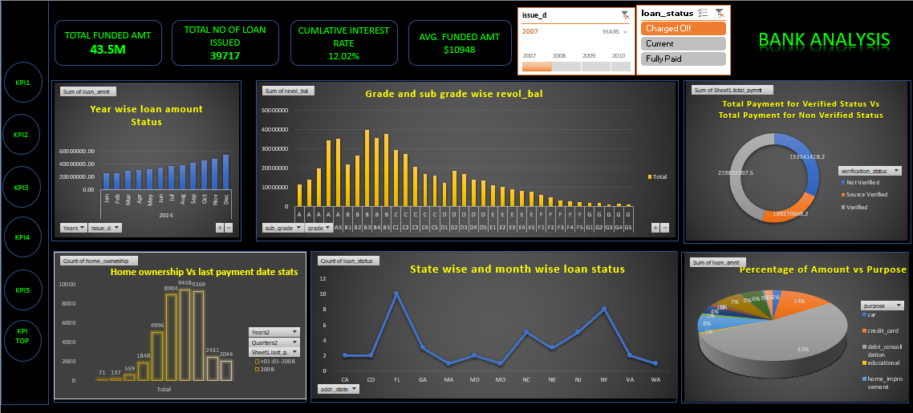

Slide 15
My sql
Cleaning of Data As per KPIs
Created Database In My Sql
Imported Both Finance_1 & Finance_2 through Import Wizard
Wrote required syntax as per KPIs

Slide 16
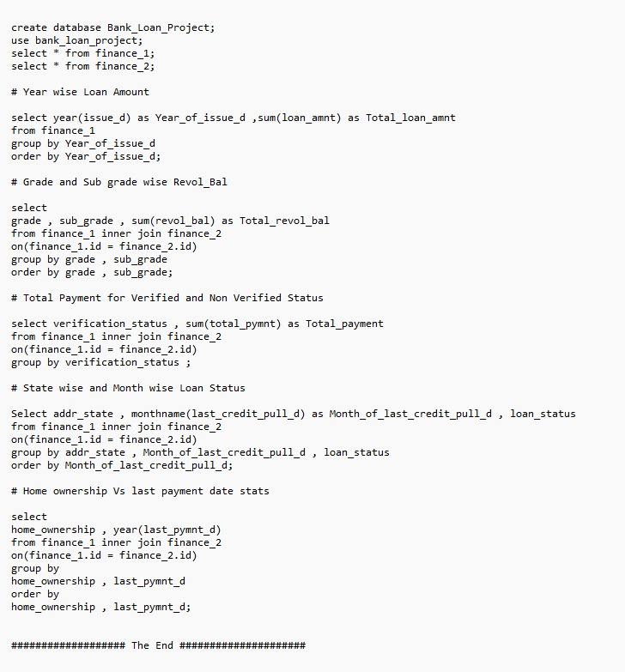

Slide 17
POWER BI
Imported data in power bi.
Cleaned the data and transform the data.
Automatic relationship created between finance_1 and finance_2.
Created visuals according to the KPI’s.
Designed all visuals on single sheet for dashboard.

Slide 18
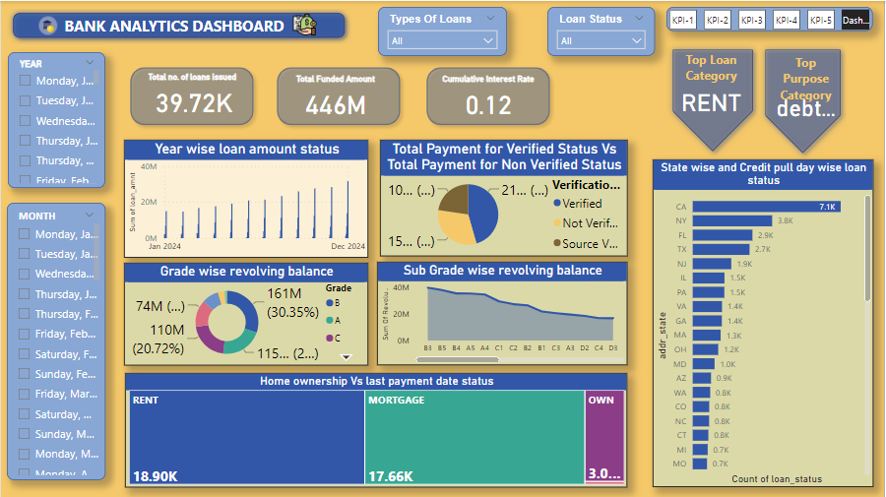

Slide 19
Tableau
We have to connect finance_1and finance_2 datasets to each other.
Create Union for both files.
Then clean and transform data.
Visualization Layout – 1.Choose the right chart type.
2.configure chart properties.
3.Add filters and highlights.
Dashboard layout- 1.Add sheets
2.Arrange Sheets
3.Format the dashboard

Slide 20
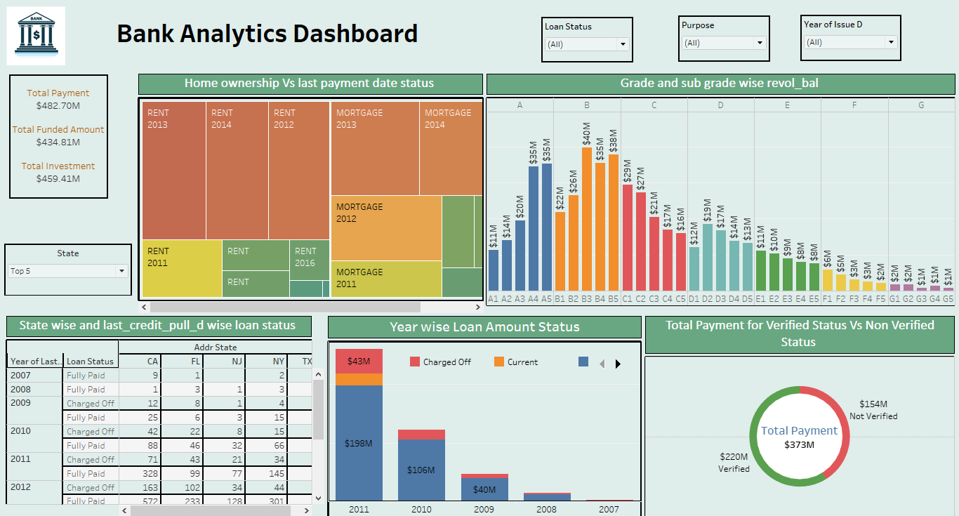

Slide 21
Facing difficulties
During project we encounter challenges like data quality issues, such as missing or inconsistent data, which affects for accuracy of analysis.
We face difficulties in integrating data from different sources into a cohesive dataset for analysis.

Slide 22
Summary
In Excel we can organize and clean our data.
Power BI helps to create visualizations and to understand the data better.
In My SQL we can type query in database for specific information.
Tableau helps in building interactive dashboards to present our findings.
Each tool plays a crucial role in different stages in project from data preparation to visualization.
It's like having a complete toolbox to unlock the insights hidden in data.

Slide 23
Thank you

